Slide 1
WPF & Database
Week / Session 12
Maryam Shahabi Lotfabadi
Adrian Gould
Namrata Aneja
ICT40518 Certificate IV in Programming
Data Driven Applications
ICTPRG431 | Apply Query Language
ICTPRG432 | Develop Data Driven Applications

Slide 2
Session Contents
WPF
Connecting to a MySQL/MariaDB
Using SQL in C#
Filling List Boxes
Creating a Filter

Slide 3
Requirements
WPF & Database 1

Slide 4
Requirements
You will require:
Windows 10 PC or Virtual Machine
Laragon with MySQL or MariaDB (preferred) running
Visual Studio 2019 (preferred)
Sample Database

Slide 5
Sample DB
WPF & Database 1

Slide 6
Sample DB
The sample DB contains:
Vehicles
Number plate
Recorded speed
Speed limit
Demerits
Above limit start
Above limit end
Penalty points
Demerit points

Slide 7
Sample DB
An SQL Script is provided to:
Create a database
Create a database user with a password
Give the user permissions to the database
Create the tables
Insert sample data into the tables

Slide 8
Sample DB
Before running any of the SQL commands you must:
Download the DemoSQL.txt file
Edit the File
Replace all xxx with YOUR initials
Save the updated file
Copy the content of the file to the clipboard

Slide 9
Sample DB
Make sure Laragon is running
Ensure that:
Apache is running
MariaDB or MySQL 8+ are running
Open Database GUI (usually PhpMyAdmin)
Click the database button
Log into PhpMyAdmin using:
Username: root
Password: Leave this blank/empty

Slide 10
Sample DB
Once logged in:
Click on SQL tab
Paste the SQL code into the editor area
Click Go
If there are any errors make sure you have changed all the xxx to your initials

Slide 11
Setting up the Project
WPF & Database 1

Slide 12

WPF & Database 1
Open Visual Studio
Close any open project/solution
You should have the “splash screen”
Click Create a new project

Slide 13


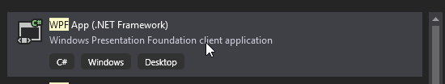
WPF & Database 1
In the search box type WPF
In the drop down menus select:
C#
Windows
Desktop
Scroll through the list to find:
WPF App (.NET Framework)
Click to select
Click Next

Slide 14
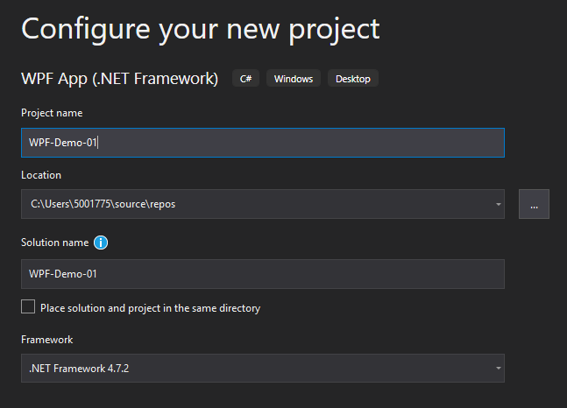
WPF & Database 1
Name the project:
Week-12-WPF-Database-01 (the picture shows a generic name for illustration purposes)
The Framework should be
.NET Framework 4.7.2 or later

Slide 15
Adding MySQL.Data Package
WPF & Database 1

Slide 16
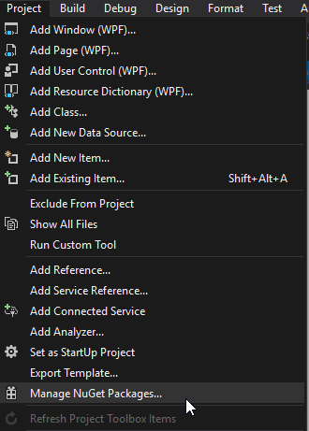
Adding the MySQL Data package
Once the base application is created we need to add the MySQL Data package
Use these steps:
Click Project to open the menu
Locate and click “Manage NuGet Packages…”

Slide 17
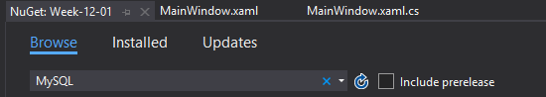

Adding the MySQL Data package
When the tab opens, click on:
Browse
Type in MySQL in the search area
Select the MySQL.Data option from the list (will be version 8.0.24 or later)

Slide 18
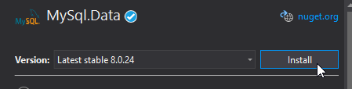
Adding the MySQL Data package
Once selected on the right check the version
Then click Install

Slide 19
Adding the MySQL Data package
Once the package is installed
Click on the MainWindow.xaml tab
We are ready to create our window layout

Slide 20
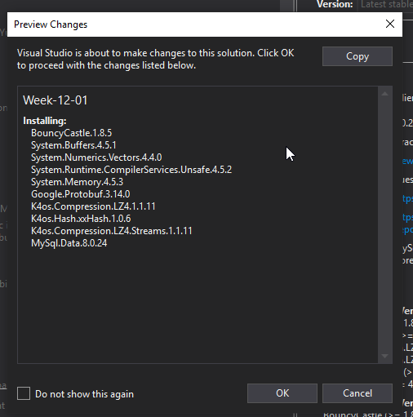
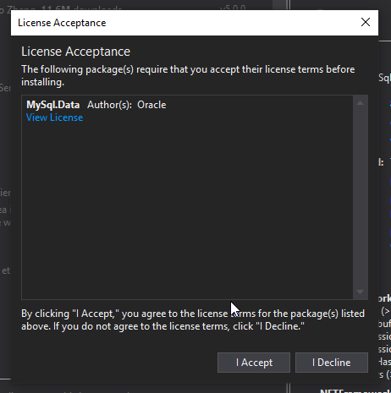
Adding the MySQL Data package
You will need to respond to two (maybe more) dialog boxes with OK/Agree
Preview Changes
License Acceptance

Slide 21
Creating the GUI Layout
WPF & Database 1

Slide 22
Creating the GUI Layout
The MySQLConnection will be highlighted.
Put the cursor in this word and press
CTRL+. (Control Full-stop)
When the pop up appears select:
Using MySql.Data.Client;
This adds the required link to the MySQL.Data package

Slide 23
Creating the GUI Layout –XAML file
Week_12…_01 will match the name of your project… Do not change this
Updating the title
Edit the Window definition to read:
<Window x:Class="Week_12_WPF_Database_01.MainWindow"
xmlns="http://schemas.microsoft.com/winfx/2006/xaml/presentation"
xmlns:x="http://schemas.microsoft.com/winfx/2006/xaml"
xmlns:d="http://schemas.microsoft.com/expression/blend/2008"
xmlns:mc="http://schemas.openxmlformats.org/markup-compatibility/2006"
xmlns:local="clr-namespace:Week_12_WPF_Database_01"
mc:Ignorable="d"
Title="Week 12: WPF Database Integration" Height="450" Width="800">
Width and Height – default window size
MinWidth, MaxWidth, MinHeight, MaxHeight to limit size

Slide 24
Creating the GUI Layout
Add the Grid column definitions inside the <Grid> … </Grid> tags:
<Grid.ColumnDefinitions>
<ColumnDefinition Width="24"/>
<ColumnDefinition Width="1*"/>
<ColumnDefinition Width="2*"/>
<ColumnDefinition Width="24"/>
</Grid.ColumnDefinitions>
24 is a fixed width
1* and 2* provide for the remaining area to be divided into parts of size 1/3 and 2/3

Slide 25
Creating the GUI Layout
Add the row definitions, after the Column definitions:
<Grid.RowDefinitions>
<RowDefinition Height="16"/>
<RowDefinition Height="1*"/>
<RowDefinition Height="1*"/>
<RowDefinition Height="1*"/>
<RowDefinition Height="1*"/>
<RowDefinition Height="1*"/>
<RowDefinition Height="16"/>
</Grid.RowDefinitions>
16 is a fixed height
Having five 1* gives each row 1/5 of the height of the remaining space

Slide 26
Creating the GUI Layout
Next we add the Label after the Row definitions, but before the </Grid> tag:
<Label
x:Name="SearchLabel"
Content="Search"
Grid.Column="1"
Grid.Row="1"
Margin="8"
FontSize="24"
/>
Create a label in the 2nd row and 2nd column.
We refer to it as “SearchLabel” in our C# code.
The label the text is “Search”.
The margin is 8, so the label will fill all space but be ”8” from the edge of the grid cell.

Slide 27
Creating the GUI Layout
Next we add the Filter textbox, again before the </Grid> tag:
<TextBox
x:Name="SearchTextbox"
Grid.Column="2"
Grid.Row="1"
MinHeight="32"
Margin="8"
TextWrapping="Wrap"
Text=""
FontSize="24"
/>
Create a Text Box
Row 2, Column 3
Fill whole cell but ’8’ from the sides
Wrap the Text
Set a minimum height, which takes effect when window resizing

Slide 28
Creating the GUI Layout
Next we add the Button, again before the </Grid> tag:
<Button
x:Name="FillButton"
Content="Fill List"
FontSize="24"
Grid.Column="1"
Grid.Row="2"
Margin="8 "
/>
Create a Button
Row 3, Column 2
Fill whole cell but ’8’ from the sides

Slide 29
Creating the GUI Layout
Finally the Listbox is added…
<ListBox
x:Name="VehicleListbox"
Grid.Column="2"
Grid.Row="2"
Grid.RowSpan="3"
Background="LightGray"
Margin="8"
Padding="8"
/>
Create a List Box
C# Name “VehicleListBox”
Row 3, Column 3
Spread over 3 rows total
Light Grey background
Fill whole cell but ’8’ from the sides

Slide 30
Creating the GUI Layout
Font Size
Set to 24 illustration purposes
Remove before continuing
We omitted the event hooks purposely
We will create them now…

Slide 31
Creating the GUI Layout
Edit the Button and add the following event hook:
Click=""
This will be before the /> on the Button element
A dialog will pop up to ask if you want to create a new event handler
Click this and the event handler will be added:
Click="FillButton_Click"

Slide 32
Xaml code will look like this
<Grid>
<Grid.ColumnDefinitions>
<ColumnDefinition Width="24"/>
<ColumnDefinition Width="1*"/>
<ColumnDefinition Width="2*"/>
<ColumnDefinition Width="24"/>
</Grid.ColumnDefinitions>
<Grid.RowDefinitions>
<RowDefinition Height="16"/>
<RowDefinition Height="80*"/>
<RowDefinition Height="80*"/>
<RowDefinition Height="80*"/>
<RowDefinition Height="42*"/>
<RowDefinition Height="39*"/>
<RowDefinition Height="80*"/>
<RowDefinition Height="16"/>
</Grid.RowDefinitions>

Slide 33
Add Search label
<Label x:Name="SearchLabel"
Content="Search"
Grid.Column="1"
Grid.Row="1"
Margin="8,8,8,8"
FontSize="24"
/>

Slide 34
Add search Text Box & a Button
<TextBox
x:Name="SearchTextbox"
Grid.Column="2"
Grid.Row="1"
MinHeight="32"
Margin="8,8,8,8"
TextWrapping="wrap"
Text=""
FontSize="14"
/>
<Button x:Name="FillButton" Content="Fill list"
Click="FillButton_Click" FontSize="14"
Grid.Column="1" Grid.Row="2" Margin="8,8,8,8"/>

Slide 35
Add a List box
<ListBox
x:Name="VehicleListbox"
Grid.Column="2"
Grid.Row="2"
Grid.RowSpan="4"
Background="LightGray"
Margin="8,8,8,8"
Padding="8"
/>
</Grid>

Slide 36
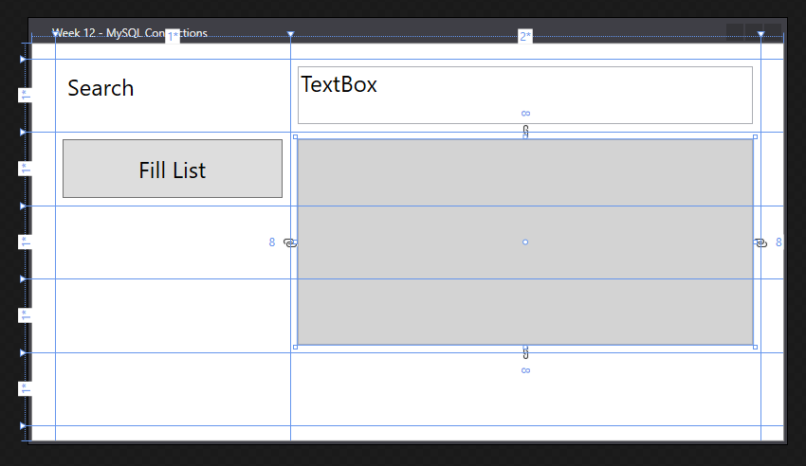
After adding various tool tags in the Grid tag, the xaml screen will look like this.
We added:
Grid column/rows
Search Label
Textbox
Listbox
Button Fill List

Slide 37
Creating the GUI Layout in MainWindow.xaml.cs
At the top of the MainWindow class definition we need to add:
Private properties
Constructor code

Slide 38
Creating the GUI Layout in C#
Private properties declared
public partial class MainWindow : Window
{
// Define Connection Details
private string dbName = ”xxx_traffic_cop";
private string dbUser = ”root";
private string dbPassword = “ ";
private int dbPort = 3306;
private string dbServer = "localhost";
Continues on next slide
xxx_traffic_cop Replace xxx with your initials
MySQL/MariaDB server is on local machine and accessed by port 3306

Slide 39
Creating the GUI Layout
private string dbServer = "localhost";
// Connection String and MySQL Connection
private string dbConnectionString = "";
private MySqlConnection conn;

Slide 40
Creating the GUI Layout
The dbConnectionString is a string. C# and the MySQL package are connected by this string. The major parameters being used to connect the database are:
dbUser Database user’s name
dbName Database’s name
dbPassword Username’s password
dbServer Server name or IP address
dbPort Port used to communicate to the DB

Slide 41
Creating the GUI Layout in C#
public MainWindow()
{
InitializeComponent();
dbconnectionString = $"server={dbServer}; user={dbUser}; database={dbName}; port={dbPort}; password={dbPassword}";
conn = new MySqlConnection(dbconnectionString);
}

Slide 42
Creating the GUI Layout
With the cursor in the “FillButton_Click” press your F12 key
This will jump direct to the definition for this event handler:
private void FillButton_Click( object sender, RoutedEventArgs e)
{
}
Notes:
Event Fill Button_click adding codes in this method

Slide 43
Creating the GUI Layout
Event Handler: Button Click
private void FillButton_Click(object sender, RoutedEventArgs e)
{
string sqlQuery = "SELECT * FROM traffic;";
try
{
VehicleListbox.Items.Clear();
conn.Open();
MySqlCommand cmd = new MySqlCommand(sqlQuery, conn);
MySqlDataReader rdr = cmd.ExecuteReader();
continues on next slide
Clear the Vehicle List
Open the Database Connection
Create a new MySQL Command
Execute the command

Slide 44
Creating the GUI Layout
Event Handler: Button Click continued
while (rdr.Read())
{
VehicleListbox.Items.Add($"{rdr[1]} : {rdr[2],5}kph");
}
}
catch (Exception ex)
{
MessageBox.Show(ex.ToString());
}
conn.Close();
}
For each of the results add an item to the list box in the form:
Registration : 00000kph
Display a message box when there is an error

Slide 45
The MainWindow.xaml.cs – The Complete c# code and each code line explained below
using System;
using System.Threading;
using System.Threading.Tasks;
using System.Windows;
using MySql.Data.MySqlClient;
Continued
Notes:
Using dll files or library files of C Sharp are essential for the execution of the program/project. The Mysql.Data.MySqlClient file is one of them. This file is important to run MySql with the C sharp. The library file will change according to the Sql software. For example If we are using Sqllite at the back end the library file should be supporting Sqllite. The given file(Mysql.Data.MysSqlClient ) is supporting MySql using localhost of phpMyAdmin and is responsible for the connectivity of C sharp program and MySql.

Slide 46
The MainWindow.xaml.cs
namespace WpfApp1
{
/// <summary>
/// Interaction logic for MainWindow.xaml
/// </summary>
public partial class MainWindow : Window
{
private string dbname = "xxx_traffic_cop";
private string dbuser = "root";
private string dbpassword = "";
private int dbport = 3306;
private string dbserver ="localhost";
private string dbconnectionString = "";
private MySqlConnection conn;
Continued
Notes:
The namespace which is a container for classes is carrying public partial class of Main Window : Window, where window is a xaml class in MainWindow.xaml file. All the variables declared here are private by default.

Slide 47
The MainWindow.xaml.cs
public MainWindow()
{
InitializeComponent();
dbconnectionString = $"server={dbServer}; user={dbUser}; database={dbName}; port={dbPort}; password={dbPassword}";
conn = new MySqlConnection(dbconnectionString);
}
Continued
Notes:
Initializing the dbconnectionString variable by passing all the string array parameters.
The above can be written like this
dbconnectionString = String.Format("server={0};port={1};user={2};password={3};database={4};sslMode={5}", dbserver, dbport, dbuser, dbpassword, dbname, dbsslm);
Another explanation is about connection conn. It is declared as private MySqlConnection. This is how a connection is declared in C#. It is an object of class MySqlConnection. This class belongs to MySql.data. MySqlclient.

Slide 48
The MainWindow.xaml.cs will look like this
private void FillButton_Click(object sender, RoutedEventArgs e)
{
string sqlQuery = "SELECT * FROM traffic;";
try
{
VehicleListbox.Items.Clear();
conn.Open();
MySqlCommand cmd = new MySqlCommand(sqlQuery, conn);
MySqlDataReader rdr = cmd.ExecuteReader();
while (rdr.Read())
{
VehicleListbox.Items.Add($"{rdr[1]} : {rdr[2],5}kph");
}
}
Continued
Notes:
The event FillButton_Click
is a method executing a Sql query by using a string variable sqlQuery and displaying the result in a list box.
Try and Catch
is an exception handling way of C# that ensures that even if there is an error in the program it should keep running and displays error in a message box.
VehicleListbox.Items.Clear();
Vehicle List box is cleared by this command -VehicleListbox.Items.Clear();
conn.Open();
Connection is opened
MySqlCommand cmd = new MySqlCommand(sqlQuery, conn);
An object /instance is created with the name cmd in the class MySqlCommand and parameters like sqlQuery and conn are passed into constructor.
MySqlDataReader rdr = cmd.ExecuteReader();
MySqlDataReader is a class , you must call the ExecuteReader method/function of the MySqlCommand object. It will return MySqlDataReader object named rdr.
while (rdr.Read())
We are fetching the data using rdr object and the Read Function.
VehicleListbox.Items.Add($"{rdr[1]} : {rdr[2],5}kph");
Adding data into the Listbox to display.
Conn.close();
Connection closed

Slide 49
The MainWindow.xaml.cs will look like this
catch (Exception ex)
{
MessageBox.Show(ex.ToString());
}
conn.Close();
}
}
}
Program ends

Slide 50
MainWindow.xaml.cs. The complete Fill Button Program
private void FillButton_Click(object sender, RoutedEventArgs e)
{
string sqlQuery = "SELECT * FROM traffic;";
try
{
VehicleListbox.Items.Clear();
conn.Open();
MySqlCommand cmd = new MySqlCommand(sqlQuery, conn);
MySqlDataReader rdr = cmd.ExecuteReader();
while (rdr.Read())
{
VehicleListbox.Items.Add($"{rdr[1]} : {rdr[2],5}kph");
}
}
catch (Exception ex)
{
MessageBox.Show(ex.ToString());
}
conn.Close();
}
}
}

Slide 51
Creating the GUI Layout
Check for any errors
Then run the code
click the button
Data should be:
Read from the DB
Inserted into the list box

Slide 52
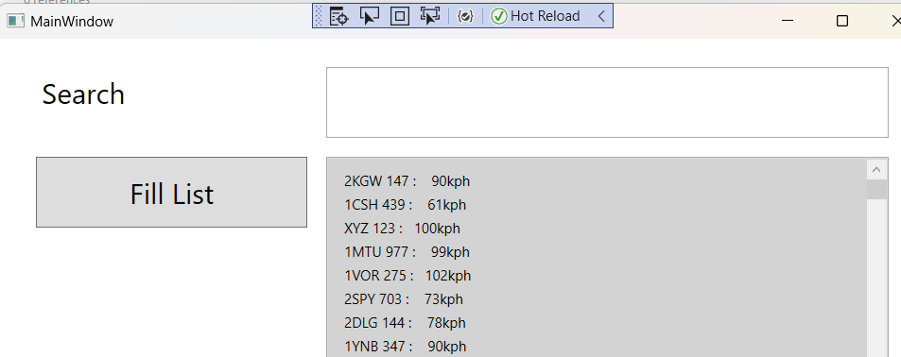
The output after executing the program
Notes:
You get an output like this.
Try these codes
try
{
VehicleListbox.Items.Clear();
conn.Open();
MySqlCommand cmd = new MySqlCommand(sqlQuery, conn);
MySqlDataReader rdr = cmd.ExecuteReader();
while (rdr.Read())
{
VehicleListbox.Items.Add($"{rdr[1],5}: {rdr[2],5}kph: {rdr[3],5}:");
}
}
catch (Exception ex)
{
MessageBox.Show(ex.ToString());
}
conn.Close();

Slide 53
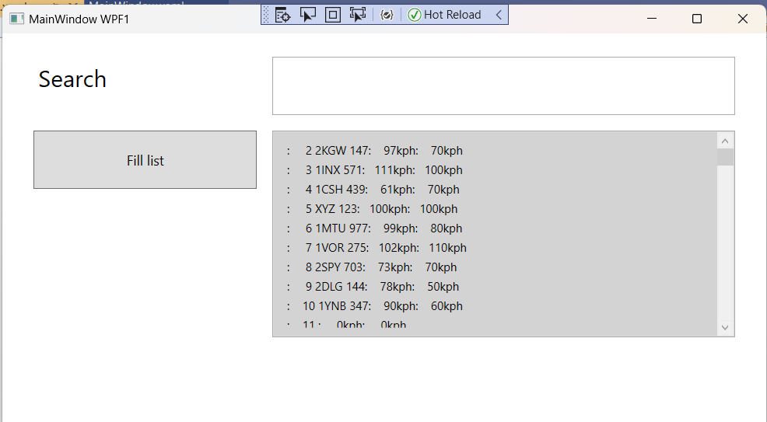
The output after executing the program
Notes:
You will get the above output by using these codes
try
{
VehicleListbox.Items.Clear();
conn.Open();
MySqlCommand cmd = new MySqlCommand(sqlQuery, conn);
MySqlDataReader rdr = cmd.ExecuteReader();
while (rdr.Read())
{
VehicleListbox.Items.Add($"{rdr[1],5}: {rdr[2],5}kph: {rdr[3],5}:");
}
}
catch (Exception ex)
{
MessageBox.Show(ex.ToString());
}
conn.Close();

Slide 54
Exercise
Create another button to fill the list box with demerits file data records.
The new Query is
sqlQuery =“ Select * from demerits ; ” ;

